Slide 1





GAMEAHOLIC
Javarris Barnett
Katelyn Bunker
Khaoula Jabour
Lane Byers
Robert Field

Slide 2
ELEVATOR PITCH
Our website, Gameaholic, is created for fans, players, and reviewers of Board Games. This website allows the fan to discover new board games and provides the fan with games that other website members have played and reviewed from the past. Consider Gameaholic a must stop if you and your friends or family are planning the next game night
Original: Grammarly Score 99 with edits
A site to keep track of board games. You can add them to a list of your favorite games you want to play again, games you hate and never want to see, or games you want to buy and play. You can also add comments on a particular game like "Josh would love this game! We should play it next time!"

Slide 3
Concept
Description – Elevator Pitch
Motivation for development? – Ya know when (story)
As a board game fanatic // I would like a place to keep track of my collection of games I've played // so that I can remember what games I've loved and hated.

Slide 4
Process
Technologies used
New Technology?
Lodash?
Node fetch?
Breakdown of tasks and roles
Javarris Barnett – Server side and backend functionality
Katelyn Bunker – API Calls and Models
Khaoula Jabour – Login and signup
Lane Byers –
Robert Field – Powerpoint, README
Challenges
Successes

Slide 5
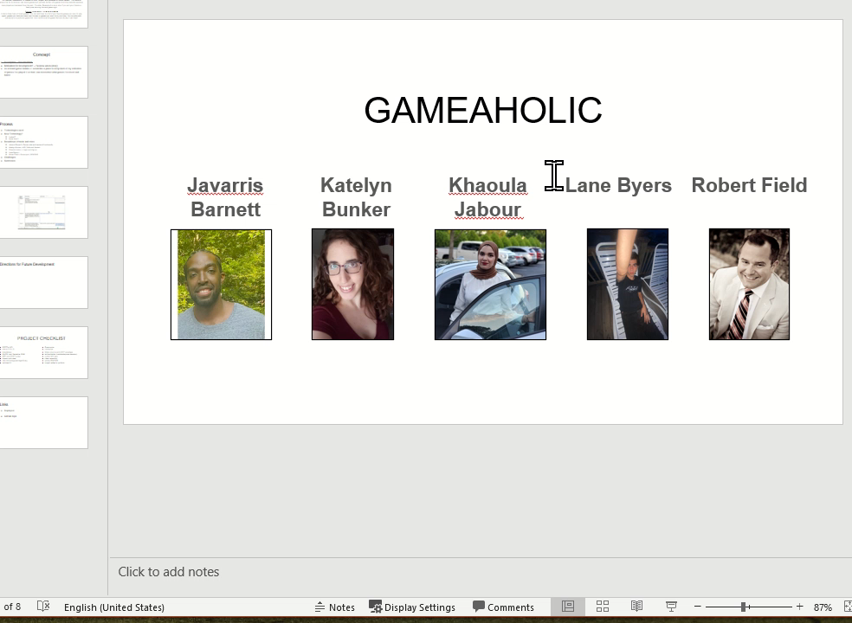
Demo

Slide 6
Directions for Future Development
Scrolling comments
Chat

Slide 7
README - KB Questions
Scrolling comments
Chat
should we have a homepage? What should users see when they are not logged in? ? show lists and the users who created them? ? allow non logged in users to see the games (and comments on those games) in the lists? -Dashboard - when logged in: Shows users lists
Button to create a new list
When user clicks on list it shows all the games in the list
When user clicks on the game (shows comments and ability to add comments)(could call boardgamegeek* api to get data about game)

Slide 8
PROJECT CHECKLIST
RESTful API
site is C.R.U.D
Handlebars
MySQL and Sequelize ORM
GET and POST routes
Heroku with data
new technology/package/library
polished UI
Responsive
Interactive
folder structure with MVC paradigm
authentication (cookies/express session)
protect API keys
clean repository
quality README
project added to portfolio

Slide 9
Links
Deployed
Live Site
GitHub repo
GitHub Repo

